Slide 1
CUTe-2
Name: Mudit Gupta
Student ID:1922
Batch: 40
Date: 15-Apr-2018
Name: Satya Alakunta
Student ID:1425
Batch: 40
Date: 15-Apr-2018
Name: Vimala Koduru
Student ID:1945
Batch: 40
Date: 15-Apr-2018

Slide 2
Problem Statement:
A healthcare organization together with a couple of government hospitals in a city has collected information about the vitals that would reveal if the person might have a coronary heart disease in the next ten years or not. This study is useful in early identification of disease and have medical intervention if necessary. This would help not only in improving the health conditions but also the economy as it has been identified that health performance and economic performance are interlinked. Given the data, we need to develop appropriate models to identify/predict if the person likely to have heart disease or not
Business Objectives:
End result should help in detecting possible CHD for a given individual, that shall help insurance company
Fix the premium appropriately
Anticipate no of claims due to CHD

Slide 3





Exploratory Data Analysis
Total Number of NAs
NA were found in A2, A15, A16
Range for Column A21, since it is normally distributed
Frequency for each bin of column A21

Slide 4
Exploratory Data Analysis
Observations which had values from A5:A12 > 1000 were termed outliers and dropped

Slide 5
Approach
Exploratory Data Analysis
Check dimensions and summary
Check NA and NA patterns
Check and separate categorical variables from data set
Check if variable can binned
Pre-Processing
Split the data into train and test
Impute train metrics (mean, median, mode, SD etc.) to test set
Drop columns which are uniform or with rare occurrence
Build Model and test
Run the model
Plot ROC
Check confusion-matrix
Tune the model (Part 1)
Apply step AIC
Plot ROC
Check confusion matrix
Tune the model (Part 2)
Check VIF and drop columns with high VIF
Build the model
Plot ROC
Check Confusion Matrix
Tune the model (Part 3)
Apply SMOTE
Build the model
Plot ROC
Check Confusion Matrix

Slide 6
Approach(contd.)
Apply LASSO
Build the model with glmnet() and alpha = 1
Plot ROC
Check Confusion Matrix
Check Sensitivity
Apply RIDGE
Build the model with glmnet() and alpha = 0
Plot ROC
Check Confusion Matrix
Check Sensitivity
Apply ElasticNet
Build the model with glmnet() and alpha = 0.5
Plot ROC
Check Confusion Matrix
Check Sensitivity

Slide 7
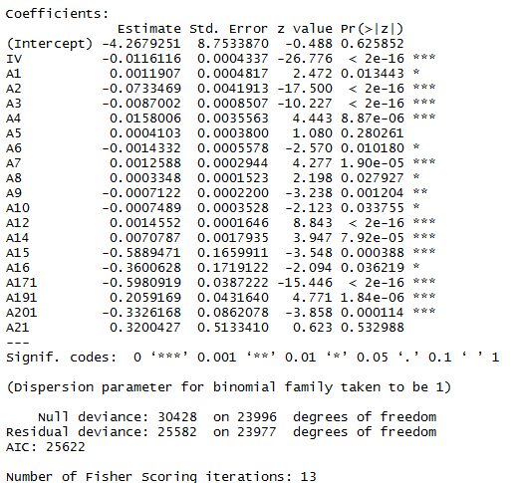
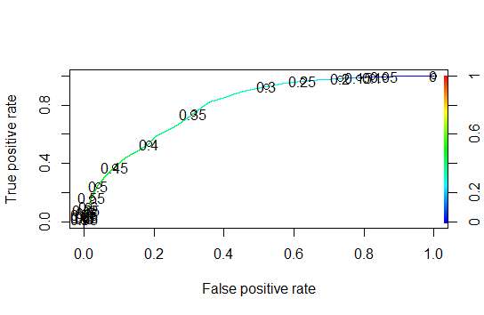



Build Model (Raw GLM)
ROC Curve
Model Statistics
79.5%
Train v/s Test

Slide 8
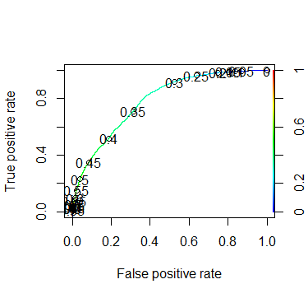



Tune Model (Part 1 – high VIF)
ROC Curve
Model Statistics
79.5%
Train v/s Test

Slide 9
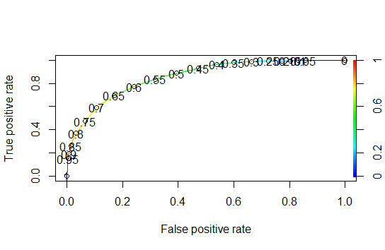



Tune Model (Part 3 - SMOTE)
ROC Curve
Model Statistics
85.5%
Train v/s Test

Slide 10
Tune Model (Part 4 - LASSO)
ROC Curve
Model Statistics
85.5%
Train v/s Test

Slide 11
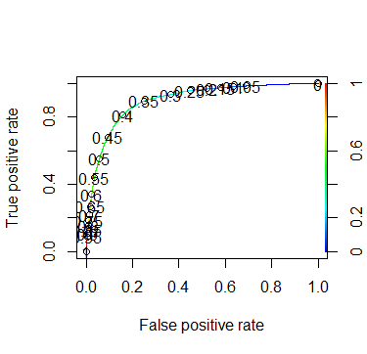



Tune Model (Part 5 - RIDGE)
ROC Curve
Model Statistics
85.5%
Train v/s Test

Slide 12
Conclusions
Data was highly imbalanced.
Maximum possible AUC is 89.9%.
Final Sensitivity is 89.3%.
Final Accuracy is 80.67%.
We choose LASSO Regression.

